Slide 1


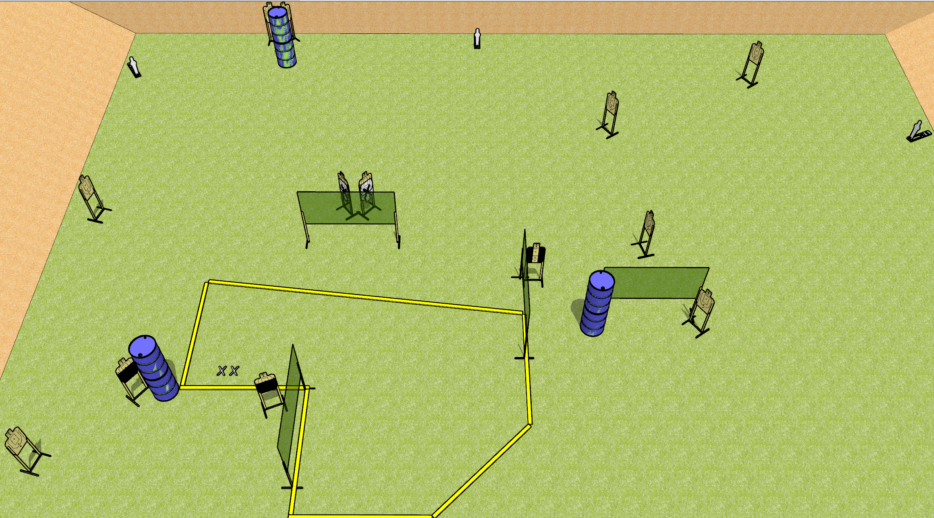
 | Dothan Gun Club – USPSA Match You Better Move Course Designer : Drew Coleman
29 rounds 13 USPSA targets 3 USPSA mini poppers
Equipment List 8 wall feet

Slide 2
You Better Move
Written Stage Briefing
You Better Move is a 29 round, 145 point, Comstock field course. There are 13 USPSA targets and 3 USPSA mini poppers. The best 2 hits on paper will score, and steel must fall to score. The start signal is audible.
Handgun start position is facing down range, feet on X’s, wrists below belt. Handgun is loaded and holstered.
PCC start position is facing down range, feet on X’s. Loaded carbine is held with both hands, safety on, stock on belt.
On start signal, engage targets as they become available from within the shooting area.

